Slide 1
www.vbaplans.com

Slide 2
Oxford SD

Slide 3
VBA Vision makes using your benefits easy
Step 1
Go to vbaplans.com, log in to your account then click “Am I Eligible”
Step 2
Click “Find a Doctor” at the top of the page. Type in your zip code or type in a doctor
Step 3
Go to your appointment and let your doctor know that you have a VBA Vision plan
Step 4
  Relax-we’ve got you covered!

Slide 4
Benefit Overview

Slide 5




Benefits Explained – Base Plan #7430
Exam | Eligible every 12 months $10 Copay | Lenses | Eligible every 12 months $25 Copay
Contacts | Eligible every 12 months $130 allowance *In lieu of spectacle Lenses & Frame | Frame | Eligible every 24 months $130 retail allowance

Slide 6
Benefits Explained – Buy-Up Plan #7431
Exam | Eligible every 12 months $10 Copay | Lenses | Eligible every 12 months $25 Copay
Contacts | Eligible every 12 months $130 allowance *In lieu of spectacle Lenses & Frame | Frame | Eligible every 12 months $130 retail allowance

Slide 7
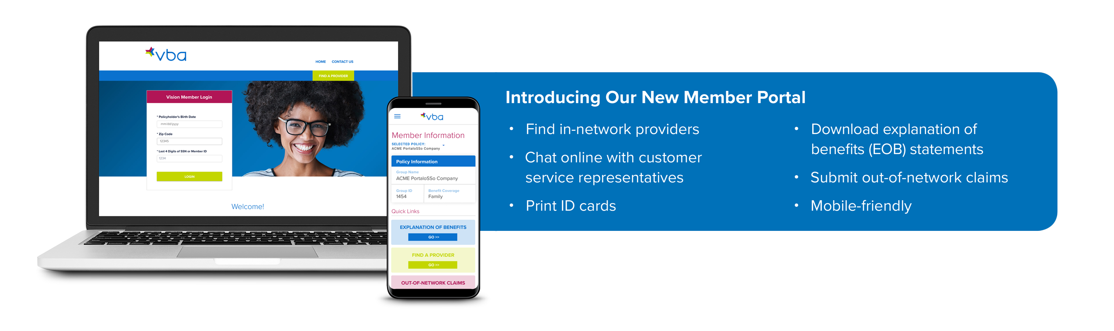
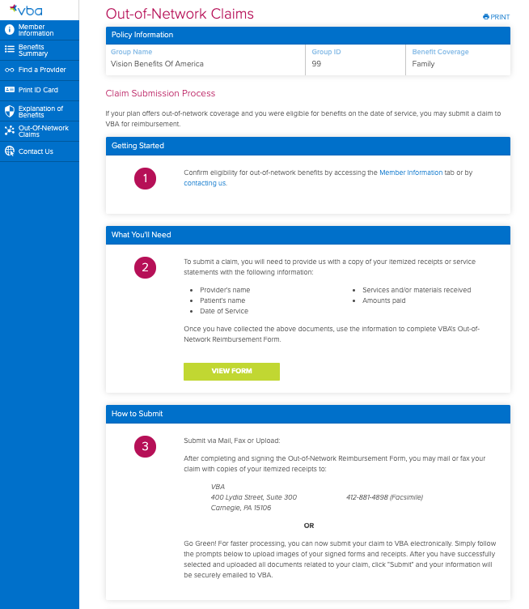
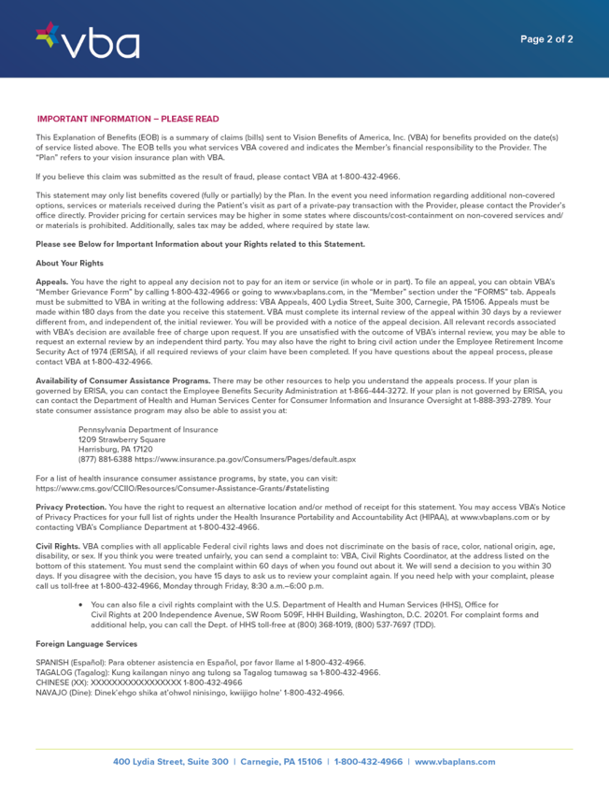

Slide 8

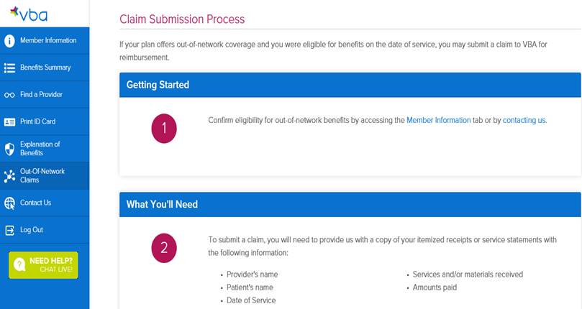

Out-of-Network Reimbursement
Go to vbaplans.com
Select “Log In”
Select “Member” “Vision”
Enter the following:
  Member DOB
  Member Zip Code
  Member last four of SS#
Select “Outside the Network”
Follow Instructions

Slide 9



Value Added Benefits
With HearUSA, VBA Members save over 40% on premium hearing aids plus a mail-in-rebate after purchase Complimentary hearing evaluation and hearing aid fitting by one of our licensed Hearing Care Professionals 3-year warranty including loss and damage coverage (deductible applies) 60-day Risk Free Trial – satisfaction guarantee 1 year supply of batteries Ongoing care including three follow up visits during the first year Discounts on accessories and professional services Bluetooth, wireless, smart phone compatible products available Friends and family of VBA Members are eligible to receive discounts To receive VBA's exclusive discounts and offers, call 855-203-7979. Qualsight/TLC LASIK Services VBA members save up to 35% off the national average prices of LASIK nationwide

Slide 10
Contact VBA

Slide 11
Contact VBA
Monday through Friday, 8:30am to 6:00pm EST
Phone – 1-800-432-4966
Fax – 412-885-5646
Email – memberservices@vbaplans.com
Website – vbaplans.com
Notes:
The ability to see clearly is key to optimal living and quality of life for all people and extends beyond health to every person’s ability to participate in and contribute to society.

